Slide 1


SECTION 1: OVERVIEW
Introduction to Data Analytics
From Raw Data to Real-World Impact

Slide 2



Course Roadmap
Phase 1: The Foundation
Phase 2: Mastery & AI
•
Introduction to Data Analytics: Concepts & Process
•
AI Tools: Making coders jealous
•
Basic Excel: The universal data tool
•
Advanced Excel: Power user techniques
•
Basic Python: Automation & AI-powered coding
•
Git & GitHub: Version control
•
SQL: Talking to databases
•
Web Dev: Dashboards & UI
•
Advanced Python: Pandas, NumPy, Matplotlib
•
Statistics & Visualization: Power BI/Tableau

Slide 3

What is Data Analytics?
"The science of analyzing raw data to make conclusions about that information."
Imagine finding a hidden pattern in a messy pile of numbers that saves your company millions. That is data analytics. It's not just about math; it's about solving problems and telling stories with facts.
Discovery Interpretation Communication

Slide 4






The 4 Types of Analytics
Descriptive
Diagnostic
Predictive
Prescriptive
What happened?
Why did it happen?
What will happen?
What should we do?
(Reports, Dashboards)
(Drill-down, Correlations)
(Trends, Forecasting)
(Optimization, Strategy)

Slide 5

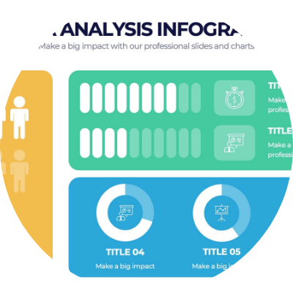
The Data Analysis Process
1.
Ask: Define the problem clearly.
2.
Prepare: Collect and store data.
3.
Process: Clean and check for errors.
4.
Analyze: Find patterns and trends.
5.
Share: Visualize and tell the story.
6.
Act: Make data-driven decisions.

Slide 6



Why Learn Data Analytics?
2.5M+
₹8.5L
60%
NEW JOBS BY 2026
AVG. ENTRY SALARY
DECISION IMPACT
High demand across all industries.
Competitive pay for skilled analysts.
Companies rely on data, not guesses.

Slide 7
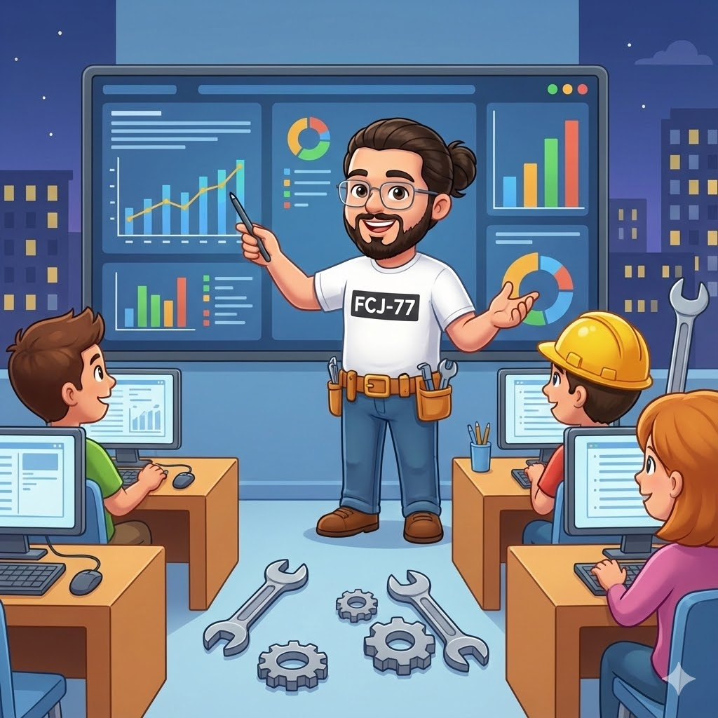
Your Toolkit
Excel
SQL
The universal language of business data.
Communicating directly with databases.
Python
Tableau/BI
Advanced analysis and automation.
Creating stunning visual dashboards.
+ Git for version control & Web Dev for presentation.

Slide 8
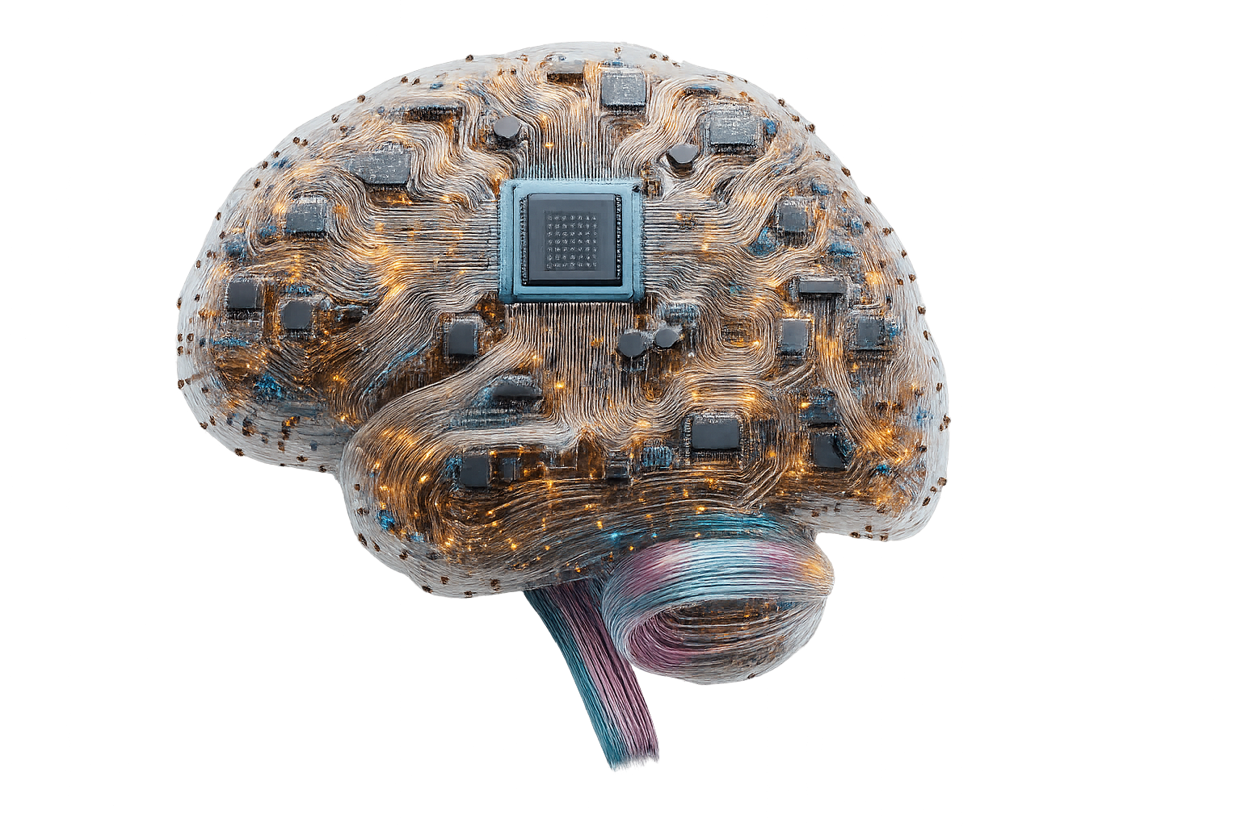


AI: The Unfair Advantage
Make Coders Jealous
In this course, we don't just learn to code; we learn to co-pilot with AI.
•
Auto-generate complex SQL queries.
•
Debug Python scripts in seconds.
•
Automate boring data cleaning tasks.
•
Predict trends with Machine Learning libraries.
"AI won't replace analysts. Analysts who use AI will replace those who don't."

Slide 9
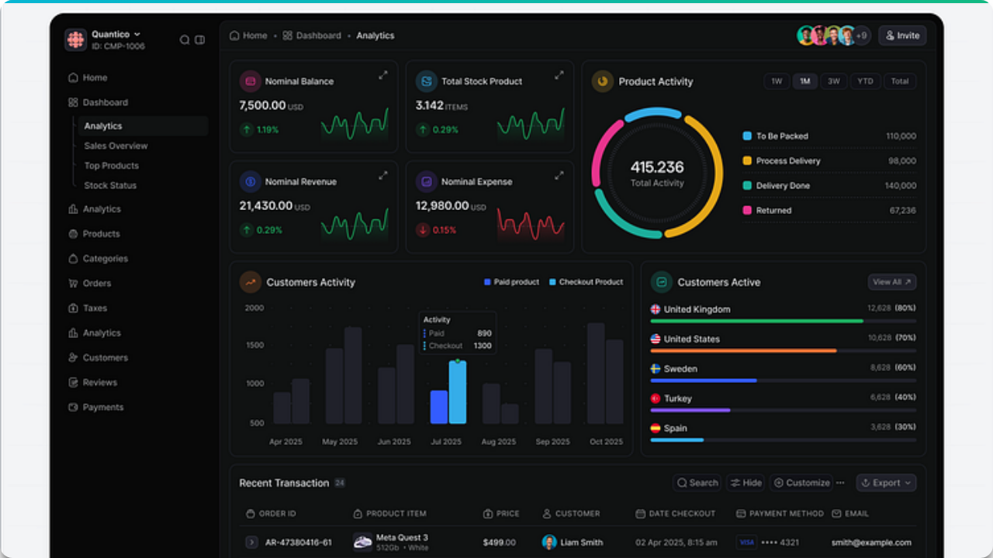

Data Visualization
Data is useless if no one understands it. We will learn to build dashboards that tell a story.

Slide 10

Thank you
Questions?

